Slide 1
Big Data Open Source Software and Projects
Aspects of Big Data Applications
I590 Data Science Curriculum
August 16 2014
Geoffrey Fox
gcf@indiana.edu
http://www.infomall.org
School of Informatics and Computing
Digital Science Center
Indiana University Bloomington

Slide 2
Other Sources of Use Cases

Slide 3
Distributed Computing Practice for Large-Scale Science & Engineering
S. Jha, M. Cole, D. Katz, O. Rana, M. Parashar, and J. Weissman,
Characteristics of 6 Distributed Applications
Application Example | Execution Unit | Communication | Coordination | Execution Environment
Montage | Multiple sequential and parallel executable | Files | Dataflow (DAG) | Dynamic process creation, execution
NEKTAR | Multiple concurrent parallel executables | Stream based | Dataflow | Co-scheduling, data streaming, async. I/O
Replica-Exchange | Multiple seq. and parallel executables | Pub/sub | Dataflow and events | Decoupled coordination and messaging
Climate Prediction (generation) | Multiple seq. & parallel executables | Files and messages | Master-Worker, events | @Home (BOINC)
Climate Prediction (analysis) | Multiple seq. & parallel executables | Files and messages | Dataflow | Dynamics process creation, workflow execution
SCOOP | Multiple Executable | Files and messages | Dataflow | Preemptive scheduling, reservations
Coupled Fusion | Multiple executable | Stream-based | Dataflow | Co-scheduling, data streaming, async I/O
Note importance of Workflow(dataflow)
Work of

Slide 4
10 Security & Privacy Use Cases
Consumer Digital Media Usage
Nielsen Homescan
Web Traffic Analytics
Health Information Exchange
Personal Genetic Privacy
Pharma Clinic Trial Data Sharing
Cyber-security
Aviation Industry
Military - Unmanned Vehicle sensor data
Education - “Common Core” Student Performance Reporting

Slide 5
7 Computational Giants of
NRC Massive Data Analysis Report
G1: Basic Statistics e.g. MRStat
G2: Generalized N-Body Problems
G3: Graph-Theoretic Computations
G4: Linear Algebraic Computations
G5: Optimizations e.g. Linear Programming
G6: Integration e.g. LDA and other GML
G7: Alignment Problems e.g. BLAST

Slide 6
S/Q/Index Category
Classical Database

Slide 7
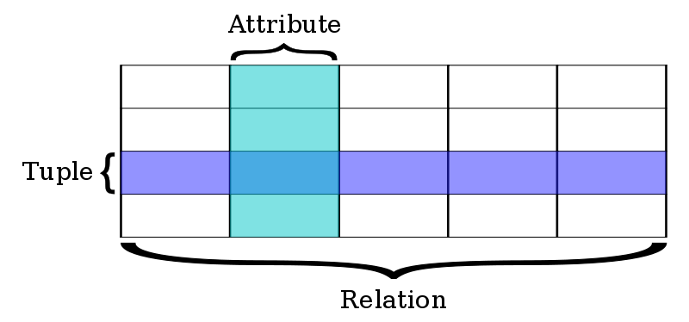
Classic Database application
Now we discuss approaches to important Search&Query and Index features
Built around predetermined table structures (“Schema-on-write”) with highly optimized queries in SQL language
OLTP Online Transaction Processing as done for bank accounts is a good example where traditional (relational) databases good.
Very good indices for quick query response
Fault tolerance done very well
This can be scaled to large systems but
parallelism is not easy – partly due to
robustness constraints.
Note bank accounts involve little computing and data is “only” large
  100 million people at ten megabytes of data (10⁵ transactions of 100 bytes) is a petabyte

Slide 8
Classic Database application
There is a vigorous debate as to which is better
  Databases or new cloud solutions typified by Hadoop for processing and NoSQL for storage?
Modern data analytics are not helped significantly by RDBMS (Relational Database management System) technologies and can run on cheaper hardware that can scale to much larger datasets than RDBMS
  SQL does not have built in clustering or recommender systems!
One can view MapReduce as exposing parallelism possible in databases and Hive+Hadoop as one example of cost effective parallel RDBMS
The RDBMS optimizations (which are great for OLTP) come at a cost so that price per terabyte per year is $1000-$2000 for a Hadoop cluster but 5-10 or more times that for a commercial RDBMS installation
  RDBMS needs more expensive servers whereas Hadoop scales on cheap commodity hardware.
  Commercial RDBMS software very expensive
ETL (Extract, Transform Load) and “Data Warehouse” are important terms in describing RDBMS approach to diverse unstructured data
  Also operational data store or ODS

Slide 9
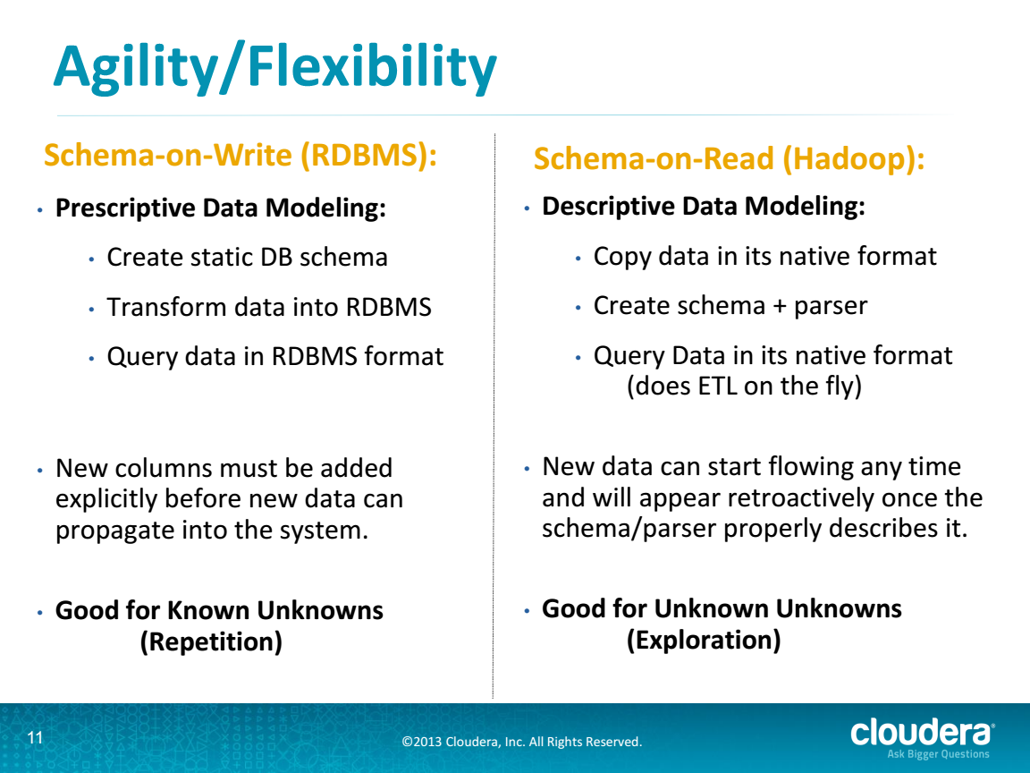
RDBMS v. Cloud from Cloudera
http://cci.drexel.edu/bigdata/bigdata2013/Apache%20Hadoop%20in%20the%20Enterprise.pdf

Slide 10
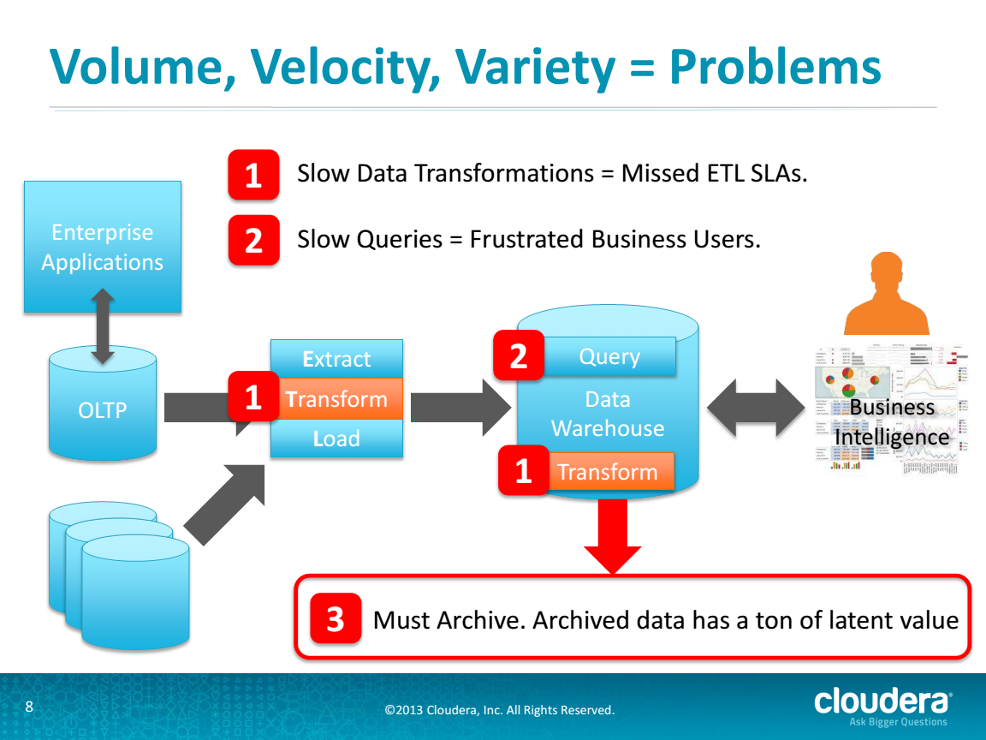
Problems in RDBMS Approach
http://cci.drexel.edu/bigdata/bigdata2013/Apache%20Hadoop%20in%20the%20Enterprise.pdf

Slide 11
Traditional Relational Database Approach
ETL = Extract, Transform, Load
20120119berkeley.pdf Jeff Hammerbacher

Slide 12
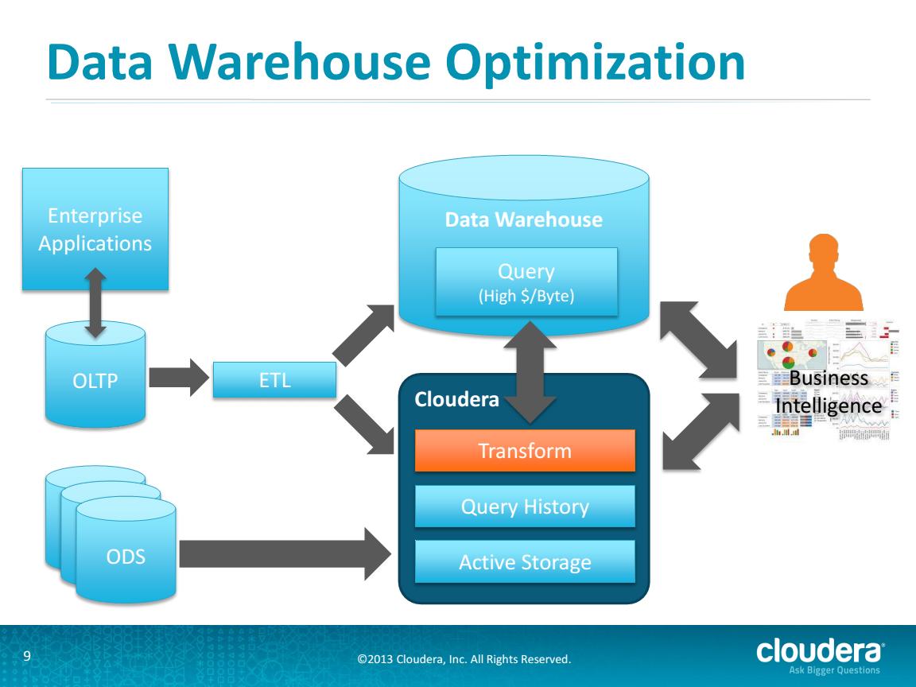
Hybrid RDBMS Cloud Solution from Cloudera
http://cci.drexel.edu/bigdata/bigdata2013/Apache%20Hadoop%20in%20the%20Enterprise.pdf

Slide 13
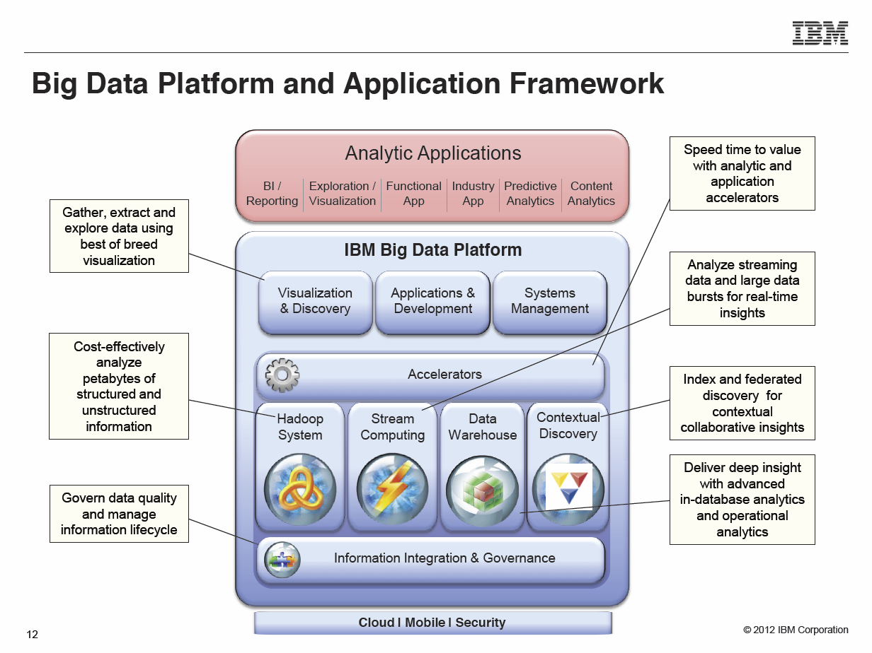
Typical Modern Do-everything Solution from IBM
Anjul Bhambhri, VP of Big Data, IBM http://fisheritcenter.haas.berkeley.edu/Big_Data/index.html

Slide 14
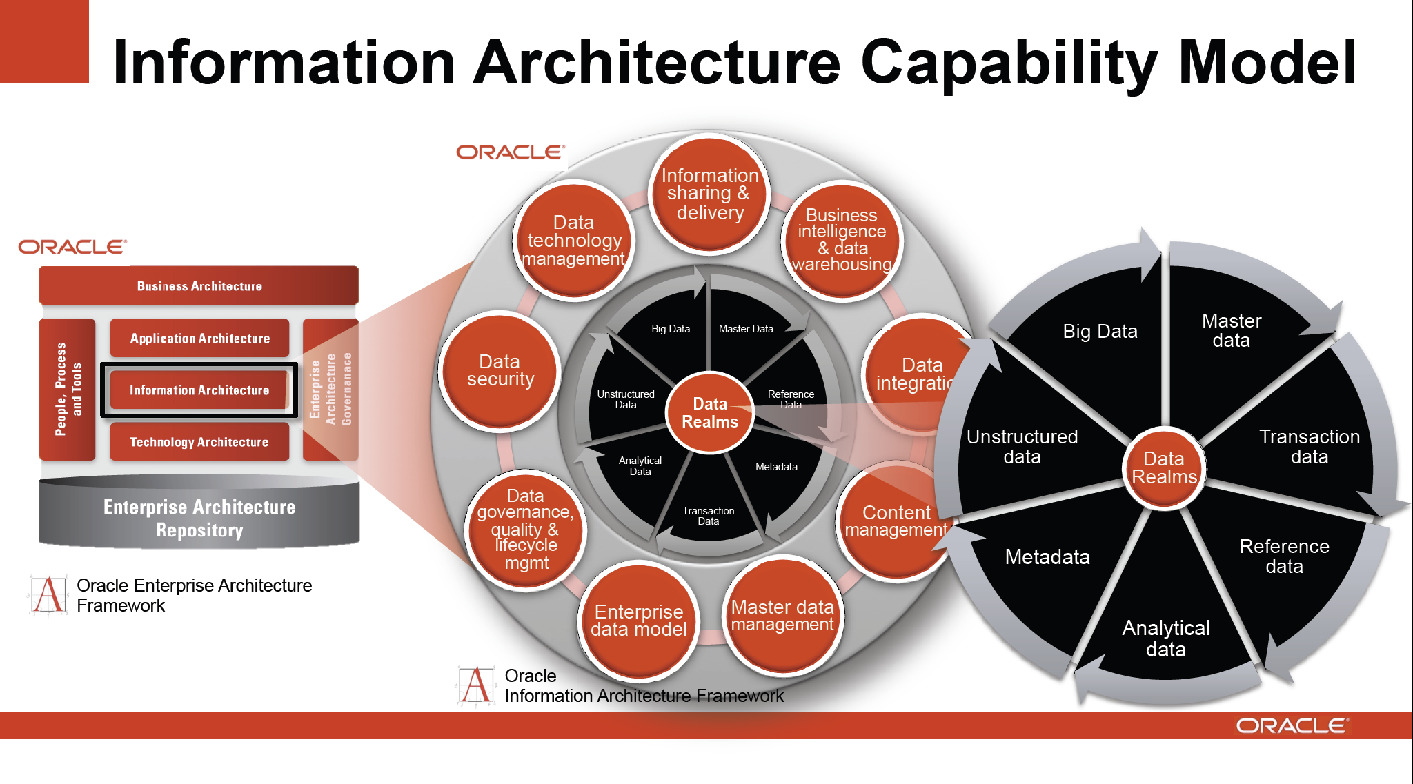
Typical Modern Do-everything Solution from Oracle
http://cs.metrostate.edu/~sbd/ Oracle

Slide 15
S/Q/Index Category
NoSQL Solutions

Slide 16
Database built on top of
NoSQL such as Hbase for media I
The “cloud” solution for databases or data systems was originally developed by the Internet companies – Google and Yahoo for search and Amazon, eBay for commerce, who needed cheaper faster solutions than relational databases.
They were driven by the commercial cloud infrastructure companies pioneered and still dominated by Amazon which made it easy for new startups (as large as Netflix) to outsource their computing flexibly
Hadoop (developed at Yahoo on MapReduce model from Google) was an important driver as MapReduce turned out to be easy to use, powerful and free.
Hadoop was developed by Apache open source process and grew many related projects forming the Apache Big Data Stack – many of them contained in Apache Bigtop project.
Cloudera was a company whose business model involves supporting and enhancing Apache big data stack

Slide 17
Database built on top of
NoSQL such as Hbase for media II
One important part of Hadoop ecosystem is Hbase which is the open source version of Bigtable which was the original Google data management system built to support distributed tables
Hbase is built on HDFS – the Hadoop File System – which correspondingly is open source version of GFS – the Google File System
  Key feature is data distributed over same nodes that do computing
  Builds in “Bring computing to the Data” Big data principle
HDFS/Hbase is equivalent of stored data in relational database
Hadoop MapReduce is equivalent of SQL processing engine although it uses Java not SQL to express processing
Hadoop runs several maps in parallel in so-called SPMD (single program multiple data) mode – each map processes a part of the data
  The Reduce step integrates the results from all maps to get full answer.

Slide 18
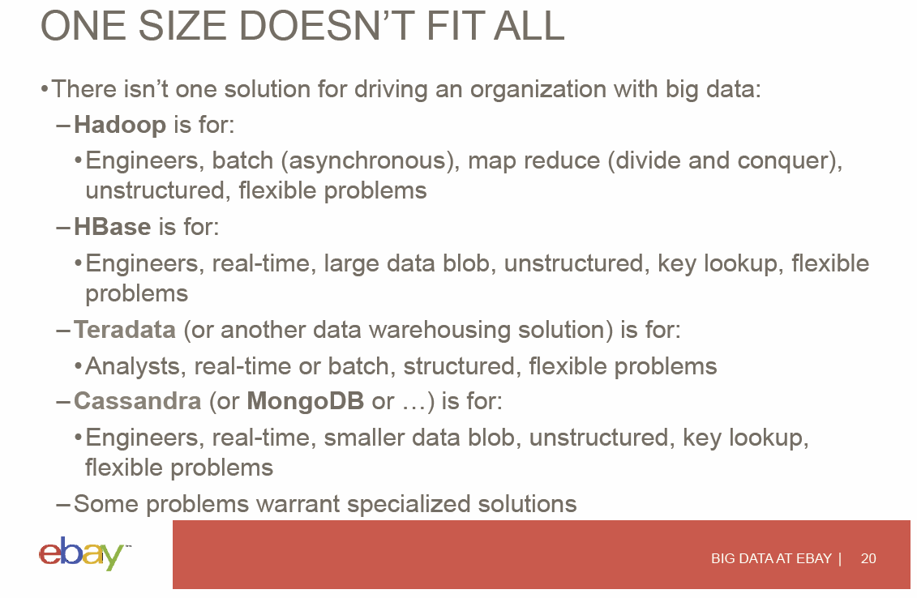
View from eBay on Trade-offs
Hugh Williams
http://fisheritcenter.haas.berkeley.edu/Big_Data/index.html

Slide 19
Parallel Global Machine Learning Examples

Slide 20
Use of MDS and Clustering
Big Data often involves looking for “structure” in data collections and then classifying points in some fashion.
“Unsupervised” investigation is one approach and here two useful techniques are clustering and MDS (Multi Dimensional Scaling).
Clustering does what name suggests – it finds collections of data that are near each other and associates them as a cluster.
MDS takes data and maps them into Euclidean space. It can be used to reduce dimension -- say to three dimensions so it can be visualized – or to take data that is not in a Euclidean space and map it into one.
Kmeans is a simple famous clustering algorithm that works on points in a Euclidean space. There are also clustering algorithms that work for non-Euclidean spaces and there also fancier clustering algorithms for Euclidean data.
Gene sequences are a good example of data points that are not Euclidean but one can calculate an estimate of distances between them. MDS maps points so distances in mapped Euclidean space are “near” distances in original space whether Euclidean or not.
Twister4Azure implements MDS and Kmeans on Azure

Slide 21
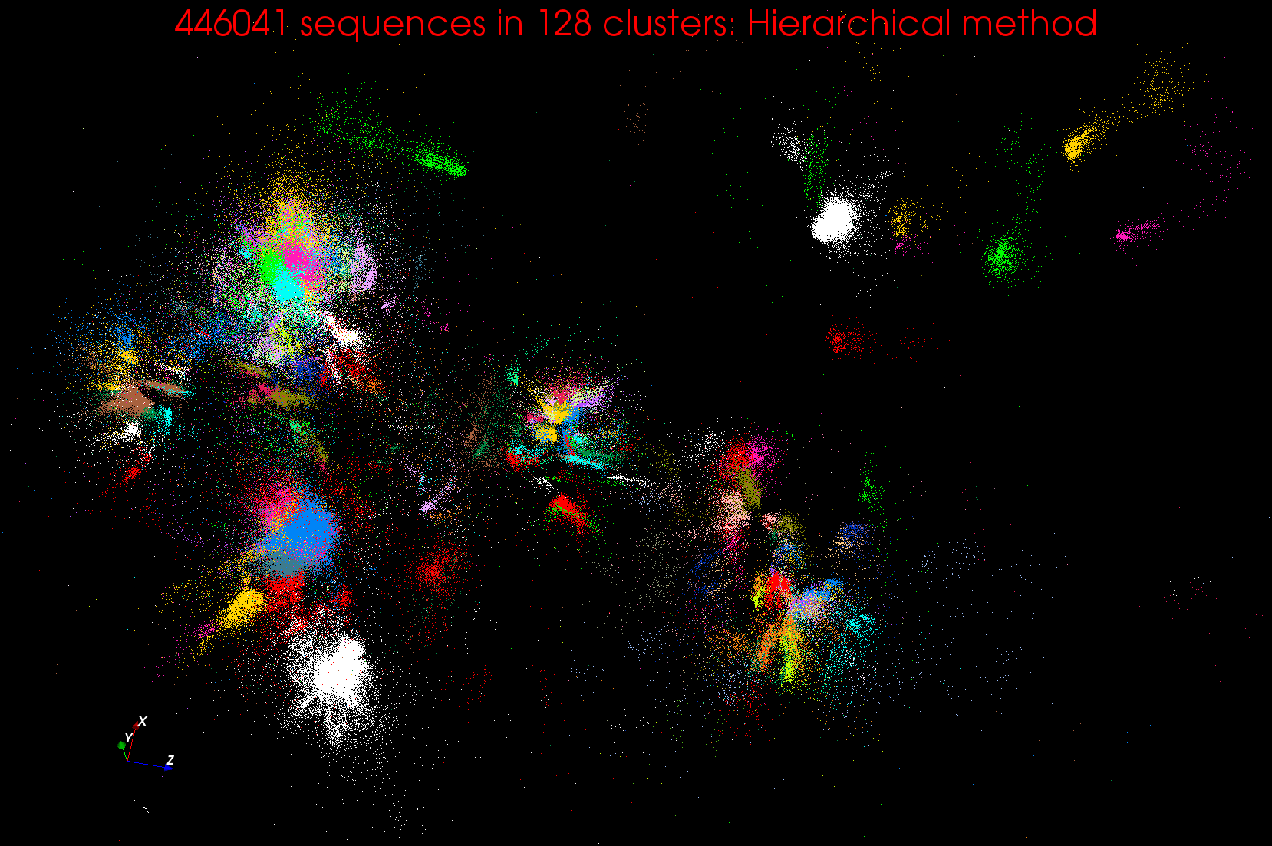
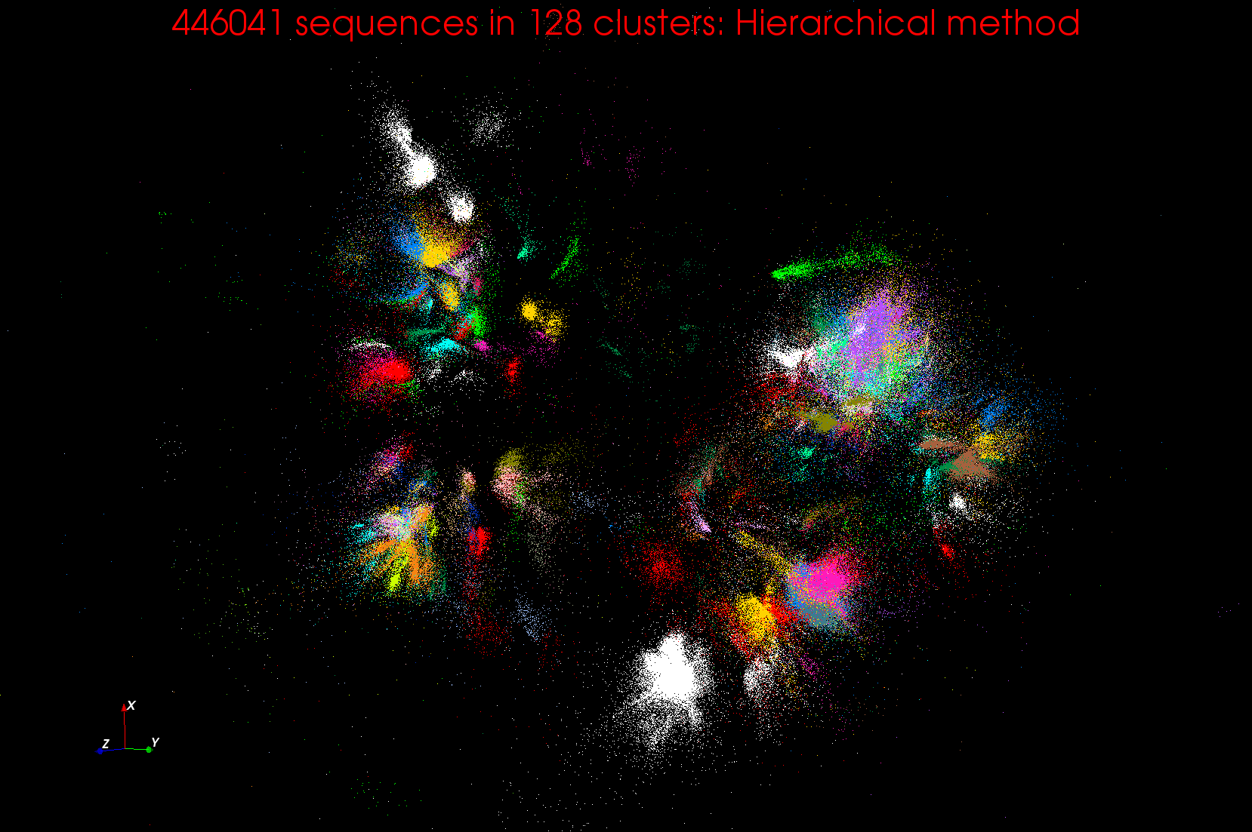
Clustering and MDS Large Scale O(N²) GML

Slide 22
Implementing Big Data

Slide 23
Useful Set of Analytics Architectures
Pleasingly Parallel: including local machine learning as in parallel over images and apply image processing to each image
- Hadoop could be used but many other HTC, Many task tools
Search: including collaborative filtering and motif finding implemented using classic MapReduce (Hadoop); Alignment
Map-Collective or Iterative MapReduce using Collective Communication (clustering) – Hadoop with Harp, Spark …..
Map-Communication or Iterative Giraph: (MapReduce) with point-to-point communication (most graph algorithms such as maximum clique, connected component, finding diameter, community detection)
  Vary in difficulty of finding partitioning (classic parallel load balancing)
Large and Shared memory: thread-based (event driven) graph algorithms (shortest path, Betweenness centrality) and Large memory applications
Ideas like workflow are “orthogonal” to this

Slide 24
Classic MapReduce
A parallel Runtime coming from Commercial Big Data Clouds
Data Partitions
Map(Key, Value)
A hash function maps the results of the map tasks to r reduce tasks
Reduce(Key, List<Value>)
Reduce Outputs
Implementations support:
  Splitting of data
  Passing the output of map functions to reduce functions
  Sorting the inputs to the reduce function based on the intermediate keys
  Quality of service

Slide 25
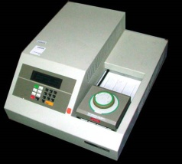
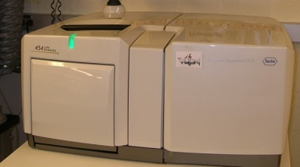
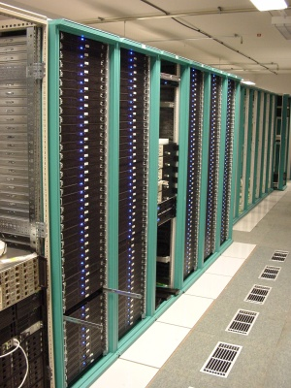
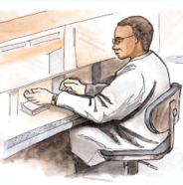


MapReduce “File/Data Repository” Parallelism
Map = (data parallel) computation reading and writing data
Reduce = Collective/Consolidation phase e.g. forming multiple global sums as in histogram
Instruments
MPI and Iterative MapReduce
Map Map Map Map
Reduce Reduce Reduce
Communication
Reduce
Portals
/Users
Disks
Map₁
Map₂
Map₃

Slide 26
4 Forms of MapReduce
(1) Map Only
(2) Classic MapReduce
(3) Iterative Map Reduce or Map-Collective
(4) Point to Point or Map-Communication
Input
Input
Iterations
Input
map
map
map
Local
reduce
reduce
Output
Graph
BLAST Analysis Local Machine Learning Pleasingly Parallel | High Energy Physics (HEP) Histograms Distributed search Recommender Engines | Expectation maximization Clustering e.g. K-means Linear Algebra, PageRank | Classic MPI PDE Solvers and Particle Dynamics Graph Problems
MapReduce and Iterative Extensions (Spark, Twister) |  |  | MPI, Giraph
Integrated Systems such as Hadoop + Harp with Compute and Communication model separated
Correspond to first 4 of Identified Architectures

Slide 27
Clouds and HPC

Slide 28
2 Aspects of Cloud Computing:
Infrastructure and Runtimes
Cloud infrastructure: outsourcing of servers, computing, data, file space, utility computing, etc..
  Azure exemplifies
Cloud runtimes or Platform: tools to do data-parallel (and other) computations. Valid on Clouds and traditional clusters
  Apache Hadoop, Google MapReduce, Microsoft Dryad, Bigtable, Chubby and others
  MapReduce designed for information retrieval/e-commerce (search, recommender) but is excellent for a wide range of science data analysis applications
  Can also do much traditional parallel computing for data-mining if extended to support iterative operations
  Data Parallel File system as in HDFS and Bigtable
  Will come back to Apache Big Data Stack

Slide 29
Clouds have highlighted SaaS PaaS IaaS
But equally valid for classic clusters
Software
(Application
Or Usage) SaaS
Education
Applications
CS Research Use e.g. test new compiler or storage model
Software Services are building blocks of applications
The middleware or computing environment including HPC, Grids …
Nimbus, Eucalyptus, OpenStack, OpenNebula
CloudStack plus Bare-metal
OpenFlow – likely to grow in importance
Cloud e.g. MapReduce
HPC e.g. PETSc, SAGA
Computer Science e.g. Compiler tools, Sensor nets, Monitors
Platform
PaaS
Infra
structure
IaaS
Software Defined Computing (virtual Clusters)
Hypervisor, Bare Metal
Operating System
Network
NaaS
Software Defined Networks
OpenFlow GENI

Slide 30
(Old) Science Computing Environments
Large Scale Supercomputers – Multicore nodes linked by high performance low latency network
  Increasingly with GPU enhancement
  Suitable for highly parallel simulations
High Throughput Systems such as European Grid Initiative EGI or Open Science Grid OSG typically aimed at pleasingly parallel jobs
  Can use “cycle stealing”
  Classic example is LHC data analysis
Grids federate resources as in EGI/OSG or enable convenient access to multiple backend systems including supercomputers
Use Services (SaaS)
  Portals make access convenient and
  Workflow integrates multiple processes into a single job

Slide 31
Clouds HPC and Grids
Synchronization/communication Performance
Grids > Clouds > Classic HPC Systems
Clouds naturally execute effectively Grid workloads but are less clear for closely coupled HPC applications
Classic HPC machines as MPI engines offer highest possible performance on closely coupled problems
The 4 forms of MapReduce/MPI with increasing synchronization
  Map Only – pleasingly parallel
  Classic MapReduce as in Hadoop; single Map followed by reduction with fault tolerant use of disk
  Iterative MapReduce use for data mining such as Expectation Maximization in clustering etc.; Cache data in memory between iterations and support the large collective communication (Reduce, Scatter, Gather, Multicast) use in data mining
  Classic MPI! Support small point to point messaging efficiently as used in partial differential equation solvers. Also used for Graph algorithms
Use architecture with minimum required synchronization

Slide 32
Increasing Synchronization in Parallel Computing
Grids: least synchronization as distributed
Clouds: MapReduce has asynchronous maps typically processing data points with results saved to disk. Final reduce phase integrates results from different maps
  Fault tolerant and does not require map synchronization
  Dominant need for search and recommender engines
  Map only useful special case
HPC enhanced Clouds: Iterative MapReduce caches results between “MapReduce” steps and supports SPMD parallel computing with large messages as seen in parallel kernels (linear algebra) in clustering and other data mining
HPC: Typically SPMD (Single Program Multiple Data) “maps” typically processing particles or mesh points interspersed with multitude of low latency messages supported by specialized networks such as Infiniband and technologies like MPI
  Often run large capability jobs with 100K (going to 1.5M) cores on same job
  National DoE/NSF/NASA facilities run 100% utilization
  Fault fragile and cannot tolerate “outlier maps” taking longer than others
  Reborn on clouds as Giraph (Pregel) for graph Algorithms
  Often used in HPC unnecessarily when better to use looser synchronization

Slide 33
Where is HPC most important in HPC-ABDS
Especial Opportunities at
  Resource management – Yarn v Slurm
  File - iRODS
  Programming – HPC parallel computing experts
  Communication – integrate best of MPI into ABDS
  Monitoring – Inca, Ganglia from HPC
  Workflow – several from Grid computing
layers for HPC and ABDS integration

Slide 34
Comparing Data Intensive and Simulation Problems

Slide 35
Comparison of Data Analytics with Simulation I
Pleasingly parallel often important in both
Both are often SPMD and BSP
  Streaming event style important in Big Data; only see in simulations for “parameter sweep” simulations
  Non-iterative MapReduce is major big data paradigm
  not a common simulation paradigm except where “Reduce” summarizes pleasingly parallel execution
Big Data often has large collective communication
  Classic simulation has a lot of smallish point-to-point messages
Simulation dominantly sparse (nearest neighbor) data structures
  “Bag of words (users, rankings, images..)” algorithms are sparse, as is PageRank
  Important data analytics involves full matrix algorithms

Slide 36
Comparison of Data Analytics with Simulation II
There are similarities between some graph problems and particle simulations with a strange cutoff force.
  Both Map-Communication
Note many big data problems are “long range force” as all points are linked.
  Easiest to parallelize. Often full matrix algorithms
  e.g. in DNA sequence studies, distance δ(i, j) defined by BLAST, Smith-Waterman, etc., between all sequences i, j.
  Opportunity for “fast multipole” ideas in big data.
In image-based deep learning, neural network weights are block sparse (corresponding to links to pixel blocks) but can be formulated as full matrix operations on GPUs and MPI in blocks.
In HPC benchmarking, Linpack being challenged by a new sparse conjugate gradient benchmark HPCG, while I am diligently using non- sparse conjugate gradient solvers in clustering and Multi-dimensional scaling.

Slide 37
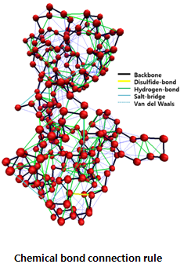
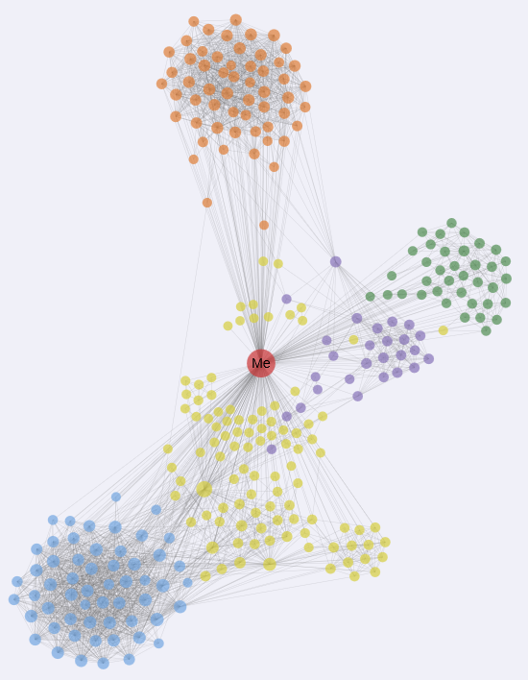
“Force Diagrams” for macromolecules and Facebook

Slide 38
Lessons / Insights
Described status of SQL and NoSQL
Described various forms of Mapreduce
4 important machine and software architectures
Described clouds v HPC and Big Data v Simulations
Global Machine Learning or (Exascale Global Optimization) particularly challenging

